Slide 1
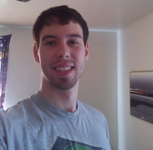
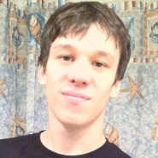
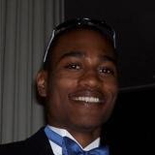
Team Organization
Nathan Lutz
- Project Manager
- Hardware Specialist
Chris Coykendall
- Web Developer
- Software Specialist
Akeem Edwards
- Financial Specialist
- Software Specialist
Brian Dunn
- Marketing Specialist
Dean Maye
- Documentation
- Software Specialist
Kevin Studevant
- Software Specialist
CJ Deaver
- Risk Analyst
Domain Expert
Kamlesh Chowdary
ITS Engineer at HRT
Domain Expert
Dr. Tamer Nadeem
Mobile Apps at ODU
Domain Expert
Dr. Michele Weigle
Vehicular Networks at ODU
Mentor
Dave Farrell
Systems Engineer at MITRE Corp.

Slide 2
Communication Methods
Direct Emails
Weekly In-person Meetings
Weekly Skype Meetings
Discussion Board

